Slide 1

Favorite Foods All Over The World
Ghazal saheb jam
Tara niakan

Slide 2

Britain
roast beef 138 calories

Slide 3
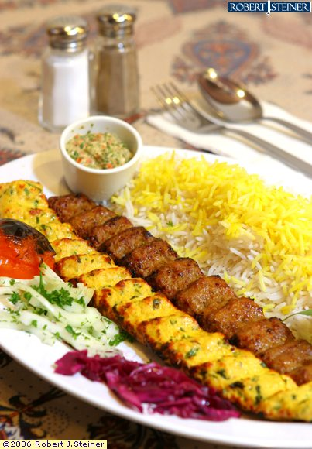
Iran
Kebab 270 calories

Slide 4
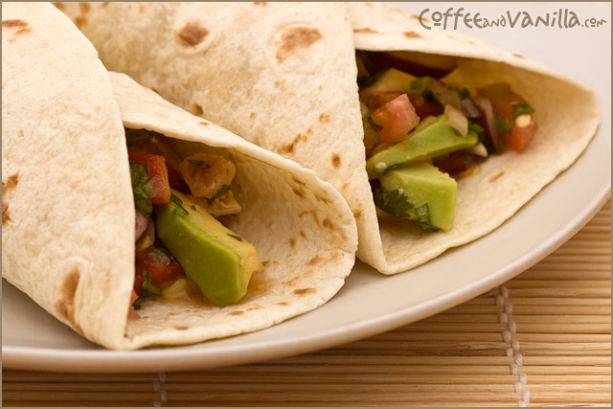
Spain
Tortilla 320 calories

Slide 5
United states
Hamburger 300 calories

Slide 6
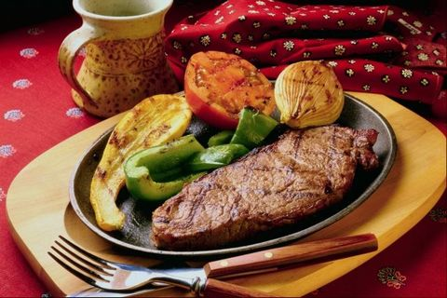
France
Steak 250 calories

Slide 7
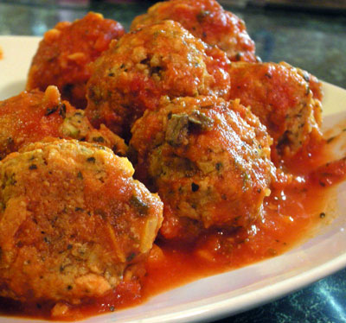
Sweden
meatballs with potatoes and lingonberry sauce 284 calories

Slide 8
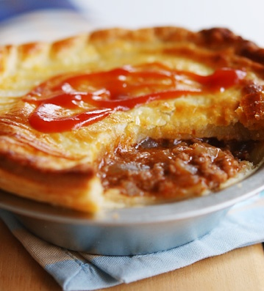
Australia
meat pies 516 calories

Slide 9
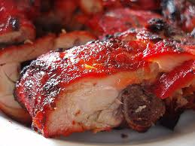
India
Tandoori chicken 214 calories

Slide 10
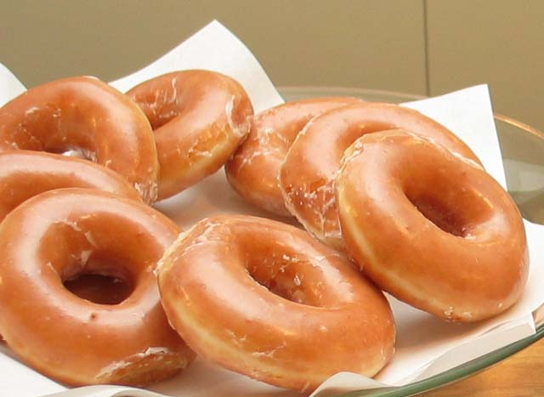
Canada
Donuts 295 calories

Slide 11
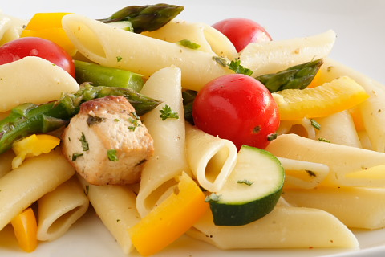
Italy
Pasta 300 calories

Slide 12
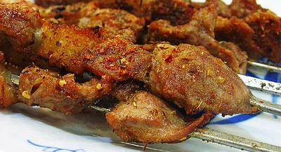
Turkey
Turkish kebab 712 calories

Slide 13
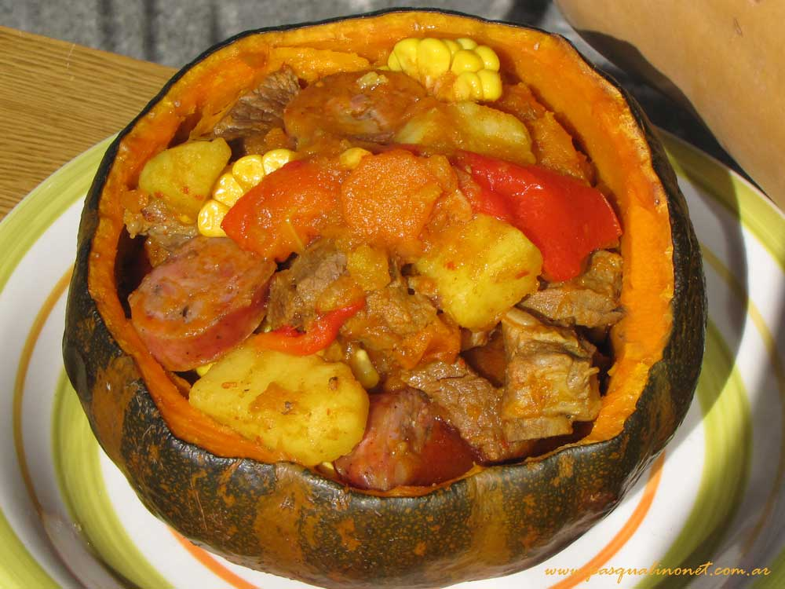
Argentina
Carbonada Criolla 285 calories

Slide 14
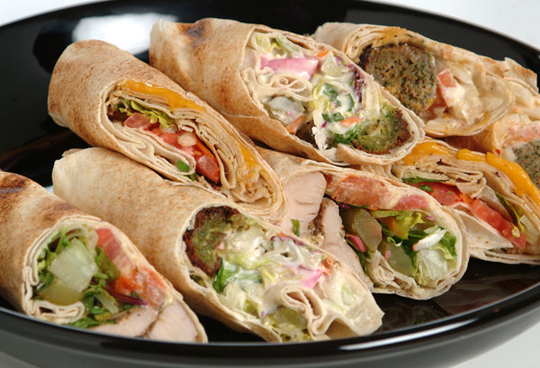
UAE
Shawarma 475 calories

Slide 15
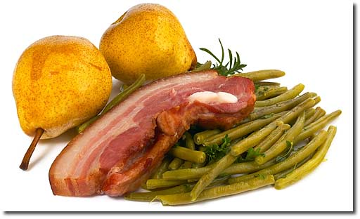
Germany
birnen, bohnen und speck 250 calories

Slide 16
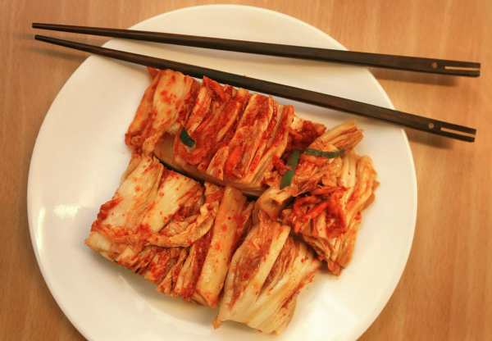
South Korea
Kimchi 100 calories

Slide 17

Japan
Sushi 361 calories

Slide 18

Thank you
life- link group : Ghazal Sahebjam
Tara Niakan

